Slide 1



Secondary Back to School Night
Welcome SAVA Students and Families!
SANTA ANA VIRTUAL ACADEMY
Thursday, September 7, 2023
Erica Graves, Principal

Slide 2

Tonight’s Program
5:30 – 5:50 PM - General Parent Meeting
  Welcome
  Introduction of Teachers and Staff
  Review of Important Information and Updates
  Parent Access to Teachers’ Course(s) Presentations (asynchronous) and Teacher/Class Links Directory
5:55 – 6:30 PM - Teacher Office Hours

Slide 3

Introduction of Teachers & Support Staff

Slide 4
SAVA Administration
Ms. Graves, Principal
Ms. Espinoza, Assistant Principal
Mr. Nuñez, Assistant Principal
Counselors
Mr. Vergara, Counselor (Grs. 6-8)
Ms. Enriquez, Counselor (Grs. 9 -10)
Ms. Quintanilla, Counselor (Grs. 11-12)
Special Needs Support Staff
Ms. Koopman, Counselor (Grs. 6-12)
Dr. Heslip, School Psychologist
Ms. Torres, Speech Pathologist

Slide 5
SAVA Secondary Teachers
English/ELA
Ms. Dreyer
Ms. Espinoza- Larrea
Mr. Hess
Ms. Shepherd
Ms. Shipley
Mr. Tran
Mathematics
Ms. Duerner
Ms. Sharma
Ms. Vasil
Ms. Skipper - Spurgeon

Slide 6
SAVA Secondary Teachers
History/Social Science
Mr. Diaz
Ms. Hardenburg
Ms. Moctezuma
Ms. Ortiz
Mr. Tran
Science
Ms. Nasr
Mr. Nimmo
Ms. Ortega
Ms. Ramirez

Slide 7
SAVA Secondary Teachers
P.E.
Mr. De La Vega
Mr. Hernandez
Mr. Suniga
CTE
Ms. Garcia
Mr. Zelaya – Substitute Teacher
ART
Ms. Stoewsand
World Languages
Ms. Valdivia
Ms. Garcia

Slide 8
SAVA Secondary Teachers
Special Education
Ms. Diaz
Ms. Kungl
Ms. Pedroza-Gomez
Ms. Stavroulakis

Slide 9
SAVA Secondary Teachers
Support Staff
Ms. Aguirre, TOSA & Testing Coordinator
Ms. Perez, Future Ready Coach
Ms. Morales, FACE Liaison
Ms. Islas-Nava, Registrar
Ms. Hernandez, Attendance Technician
Mr. Thomas, Computer Technician

Slide 10
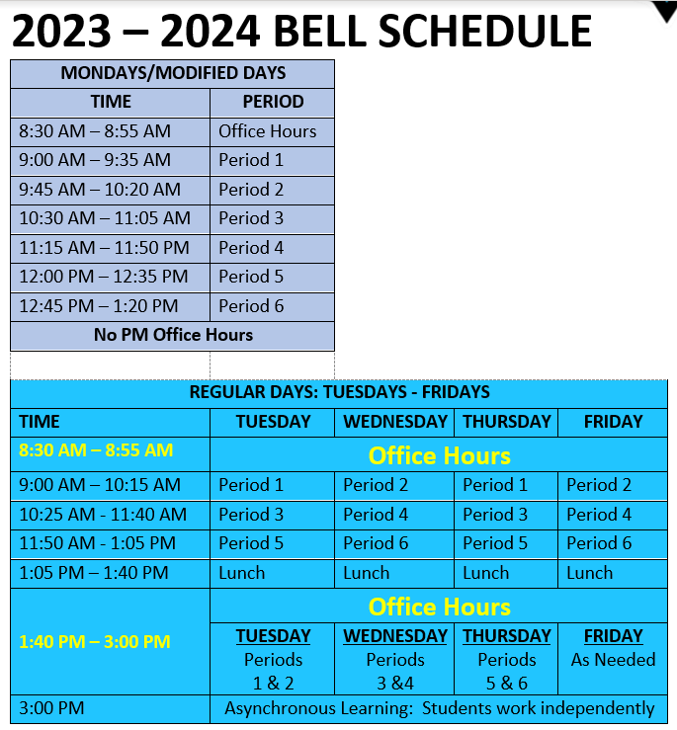
Bell Schedule
Grades 6-12

Slide 11

2023-2024 Schoolwide Focus
Attendance & Engagement
AVID Strategies
School/Home Communication

Slide 12

Focus on Attendance and Engagement

Slide 13
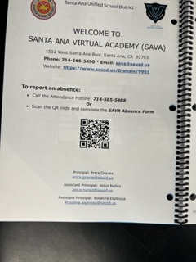

How to Report an Absence
Attendance Technician: Ms. Hernandez
Attendance Hotline: 714/565-5488
SAVA Webpage
Absence Form
QR Code:

Slide 14

Student Attendance & Engagement
Students must attend class daily and be on time.
Student cameras must be turned on during live instruction with the teacher.
Parents must report absences (partial and full-day) by calling the Attendance Hotline at 714/565-5488.
Attendance-related questions:
Ms. Hernandez, Attendance Technician

Slide 15

Student Instructional Materials & Supplies
Textbooks:
Digital & Paper Versions (available at SAVA)
Basic School Supplies:
Provided to all students
Class-Required materials and supplies (Art, Music, CTE)

Slide 16
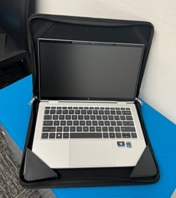
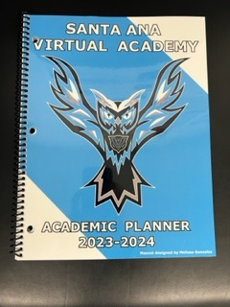
Items Ready for Pick Up

Slide 17
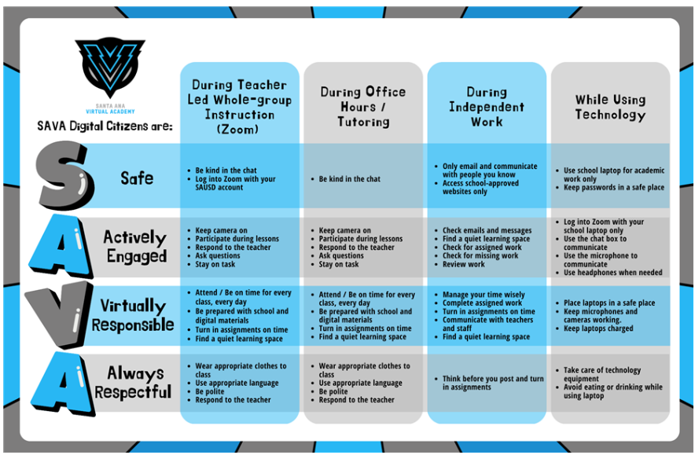
Student Engagement - PBIS

Slide 18

School Technology Support

Slide 19

Technology Issues
Computer Technician: Mr. Thomas
Pro Book (laptop) Issues:
  Shutdown Pro Book (video)
  Call the SAVA Office: 714/565-5450
  Bring the Pro Book and your child to SAVA to see Mr. Thomas
Need a hotspot?
  Call the SAVA Office: 714/565-5450

Slide 20

AVID Schoolwide Focus
What is AVID (Advancement Via Individual Determination)?
AVID is a college system that offers teaching techniques and classroom activities that educators can easily incorporate into their classrooms.
All students need to learn how to learn. Note-taking, studying, and organizing assignments are all skills that must be taught and practiced to perfect but are not explicitly taught in schools. With guided, scaffolded support from AVID, educators can teach students how to master these and other academic behaviors that will help them succeed in school and life.

Slide 21

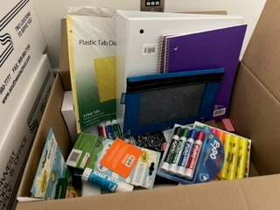
AVID Schoolwide Focus
WICOR Strategies
Writing
Inquiry
Collaboration
Organization
Reading
Organization

Slide 22
Parent Engagement Opportunities

Slide 23

Home/School Communication
SAVA Website: https://www.sausd.us/Domain/9901
Visit the teacher’s Webpage
Call the teacher’s phone number and leave a message.
Access the teacher’s Canvas course
Message the teacher on Parent Square
Aeries Parent Portal
Follow Us on Social Media

Slide 24
Monthly Parent Meetings https://sausd.zoom.us/j/7122072686
Monthly Parent Meetings - Wednesdays
August - NO MEETING
September 20, 2023 | 5:30 PM
October 18, 2023 | 5:30 PM
November 8, 2023 | 5:30 PM
December 20, 2023 | 5:30 PM
January 24, 2024 | 5:30 PM
February 21, 2024 | 5:30 PM
March 20, 2024 | 5:30 PM
April 10, 2024 | 5:30 PM
May 15, 2024 | 5:30 PM

Slide 25

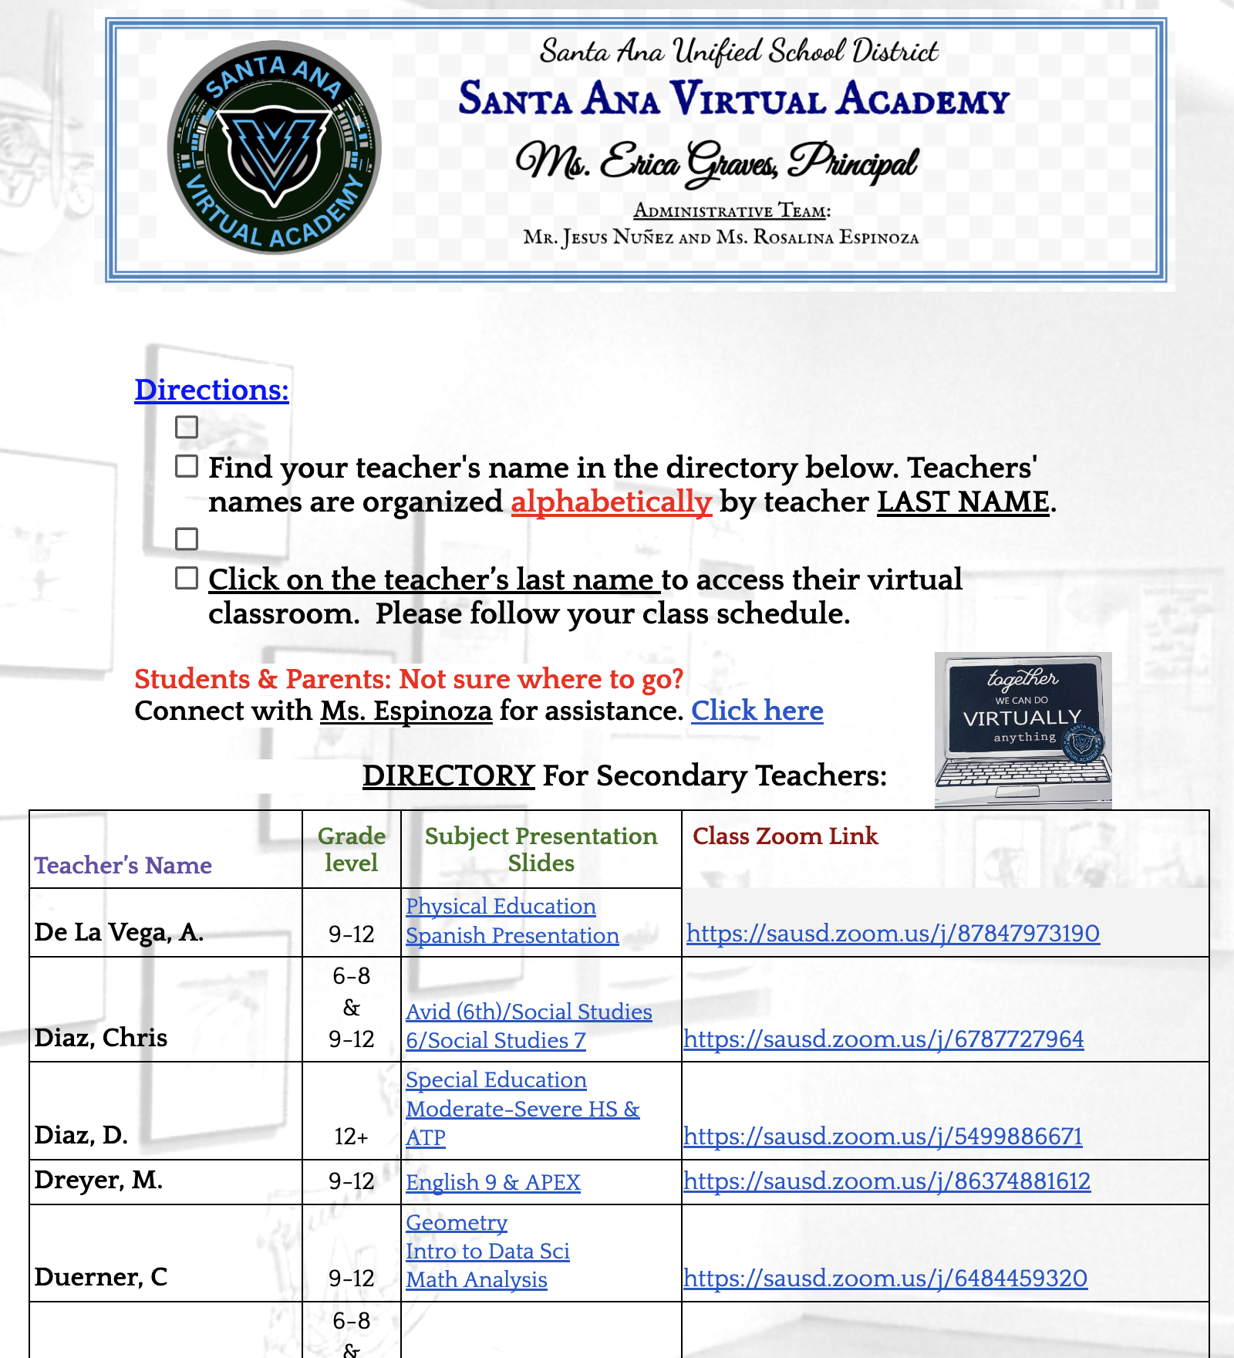
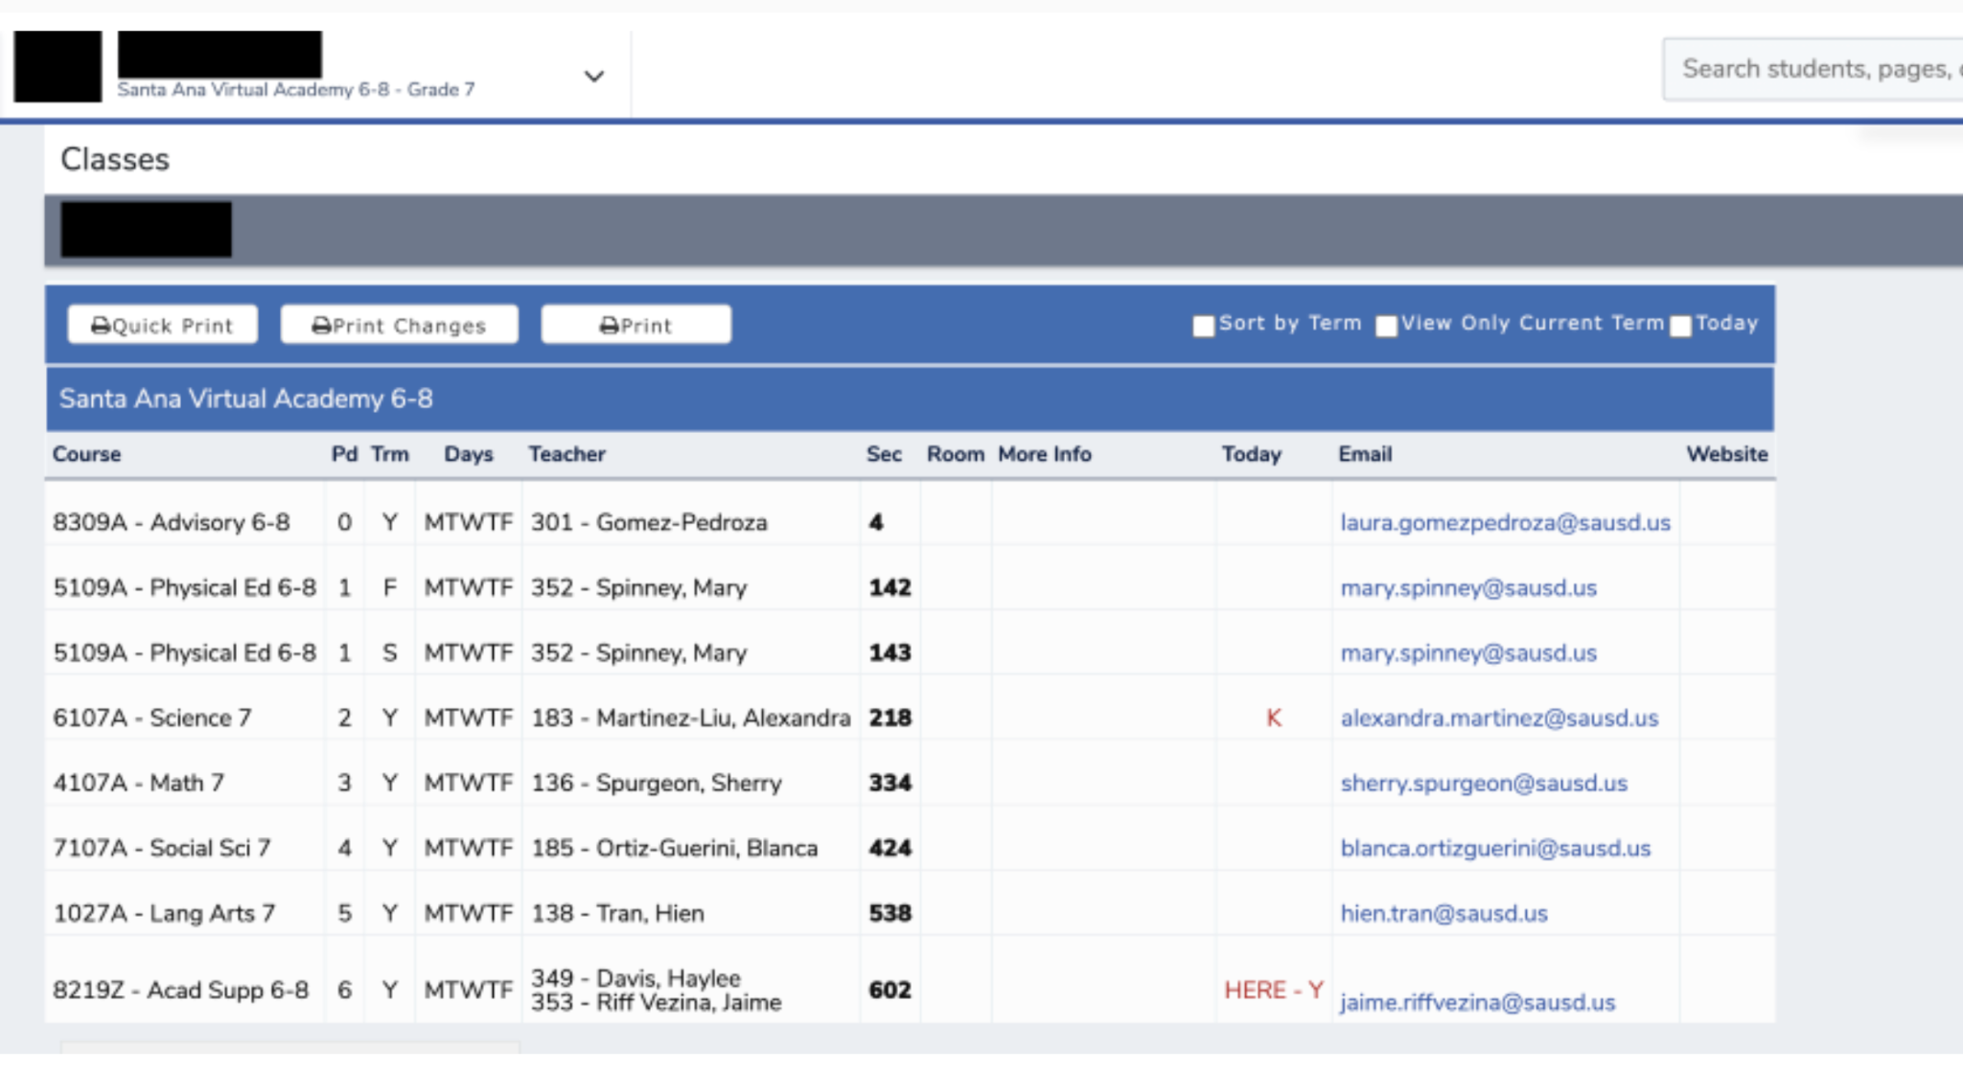
Instructions for Visiting Classes:
1st Before logging off ZOOM
Click on link in chat for Teacher
Directory
https://docs.google.com/document/d/1ublkDAE19sOaE_lsvcoCw7P8P65cIXS5joU-2UEiho8/edit?usp=sharing
“This will open up the teacher directory in a new window”
2nd Log into to Aeries (Parent Portal) to find your child’s schedule

Slide 26
Instructions for Visiting Classes:
3rd Select a teacher from your child’s
schedule:
Click on link for a slide presentation
on the directory
If you have any questions or want to
speak to that teacher click on their
Zoom link
Thank your for participating in child’s
education!

Slide 27



SAVA
Welcomes
Your family to
Back to School
Night!
Dear Secondary Parents:
If you would like to preview your child’s classroom before tonight’s “Back to School Night” Please click on the teacher directory for a slide presentation below:
https://docs.google.com/document/d/1vabcNPugqyfy-fdZX4lDhR6gUhigfbKCHOp84qzWS08/edit?usp=sharing
Tonight you will have the opportunity to speak with your child’s teachers on Zoom, we will provide a list of Zoom’s links tonight. See you all tonight!
With Appreciation,
Rosalina Espinoza
SAVA Assistant Principal

Slide 28
Thank you for joining us.

